Slide 1
Distributed Systems UNIT-1.3 PROCESSES
(Ref:Tanenbuam & Van Steen
Distributed Systems:Principles and Paradigms)

Slide 2
Topics in Processes
Threads
Virtualization
Software Agents
Clients
Servers
Code Migration

Slide 3
Introduction to Threads
Process:-
A process is defined as program in execution.
The instance of a program that is currently being executed on one of the operating system’s virtual processors.
Threads:-
A thread is a light weight process.
A thread is a path of execution within a process.
A thread executes its own piece of code independently from other threads.
A process is split itself into 2 or more simultaneously running tasks.
All threads within a process share the same address space.
A thread shares its code and data section with other threads.
Each thread has its own program counter, stack and register set.

Slide 4
Thread Types:-
User Threads:-
Threads are implemented at the user level by a thread library.
Library provides support for thread creation, scheduling and management.
User threads are fast to create and manage.
Kernel Threads:-
Supported and managed directly by the OS.
Thread creation, scheduling and management take place in kernel space.
Slower to create and manage.

Slide 5
Benefits of multithreaded processes:-
Increased responsiveness to user:-
A program continues running with other threads even if part of it is blocked or performing a lengthy operation in one thread.
Resource Sharing:-
Threads shares memory and resources of their process.
Economy:-
Less time consuming to create and manage threads than processes as threads share resources, e.g., thread creating is 30 times faster than process creating in Solaris.
Utilization of Multiprocessor Architectures:-
Increases concurrency because each thread can run in parallel on a different processor. Many applications are easier to structure as a collection of cooperating threads.
e.g., word processor - separate threads can be used for handling user input, spelling and grammar checking, document layout, index generation, etc.

Slide 6
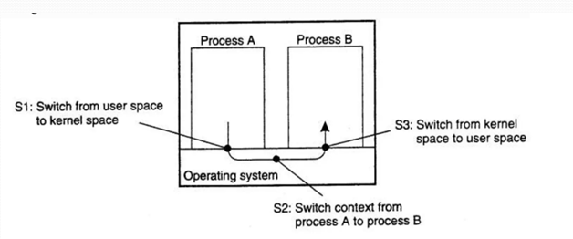
Thread Usage in Nondistributed Systems:-
This diagram showing processes without threads.
When process A Switch(S1) to kernel node,so here changing memory map in the MMU (Memory Management Unit) as well as flushing the TLB (Translation Lookaside Buffer).
When S3 occurs memory maps TLB from MMU.
The major drawback of IPC is that communication often requires extensive context switching . so, threads are needed.
Figure:-Context switching as the result of IPC

Slide 7
Thread Implementation in Nondistributed systems:-
Threads are provided in the form of a thread package.
The package contains operations to create and destroy threads as well as operations on synchronization variables such as mutexes and condition variables.
Two approaches to implement a thread package.
1. Construct a thread library that is executed entirely in user mode.
Advantages:
it is cheap to create and destroy threads
switching thread context can be done in just a few instructions
Disadvantage:
A blocking system call will immediately block the entire process to which the thread belongs, and thus also all the other threads in that process
2. Have the kernel be aware of threads and schedule them.
Advantages:
Eliminates blocking problem.
Disadvantage:
High price to pay :every thread operation (creation, deletion, synchronization, etc.), will have to be carried out by the kernel, requiring a system call.

Slide 8
Hybrid of user-level and kernel-level threads, generally referred to as lightweight processes (LWP).
An LWP runs in the context of a single (heavyweight) process
There can be several LWPs per process.
User-level thread packages can be used as well.
The package provides facilities for thread synchronization, such as mutexes and condition variables.
Mutex - mutual exclusion object.
A mutex is a program object that allows multiple program threads to share the same resource, such as file access, but not simultaneously.
When a program is started, a mutex is created with a unique name.
After this stage, any thread that needs the resource must lock the mutex from other threads while it is using the resource.
The mutex is set to unlock when the data is no longer needed or the routine is finished.

Slide 9
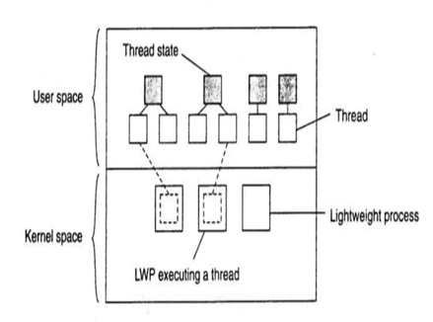
Combining kernel-level lightweight processes and user-level threads:-
The thread package is implemented entirely in user space in which all operations on threads are carried out without intervention of the kernel.
The thread package can be shared by multiple LWPs
each LWP can run its own (user-level) thread.
Multithreaded applications are constructed by creating threads, and subsequently assigning each thread to an LWP
Assigning a thread to an LWP is normally implicit and hidden from the programmer.
Figure:-Combining kernel-level lightweight processes and user-level threads

Slide 10
Threads in Distributed Systems:-
An important property of threads is that they can provide a convenient means
of allowing blocking system calls without blocking the entire process in which the thread is running.
we use,
1) Multithreaded Clients
2) Multithreaded Servers
1) Multithreaded Clients:-
It can be used to hide delay/latency in a network communication by initiating communication and immediately proceeding with something else.
Eg: Web Browser(IE,google chrome)

Slide 11
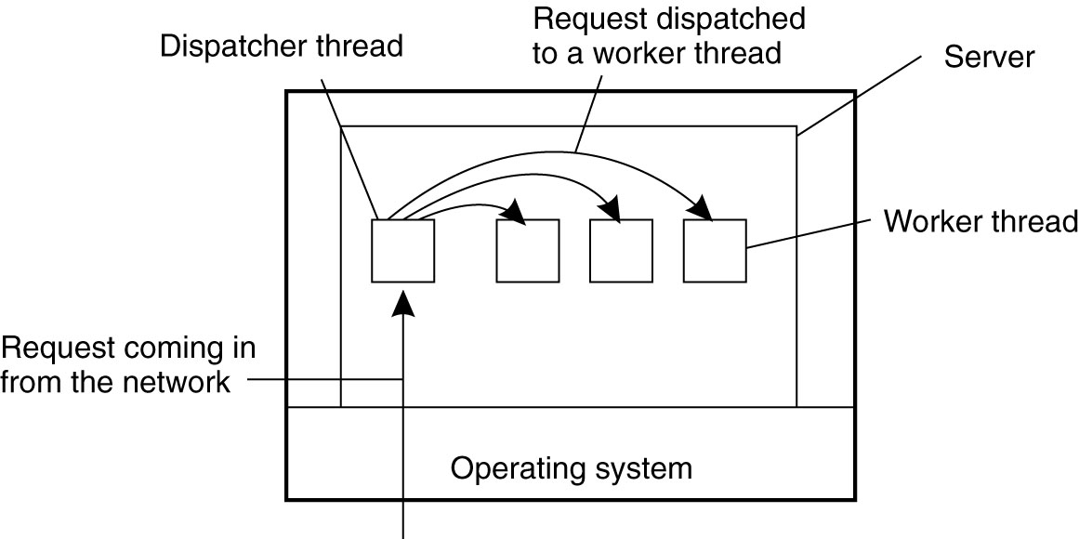
2) Multithreaded Servers:-
A multithreaded server organized in a dispathcer /worker model. eg:web server
Working of dispatcher/worker model:-
A request arrives from the network and is received by the dispatcher thread.
The dispatcher thread assigns this request to one of the available worker threads.
The worker thread processes the request, independently handling it while the dispatcher thread is free to manage additional incoming requests.
This model balances load efficiently across worker threads, allows for high concurrency, and enables the server to respond to a large number of client requests simultaneously.
Figure : A multithreaded server organized in a dispatcher/worker model.

Slide 12
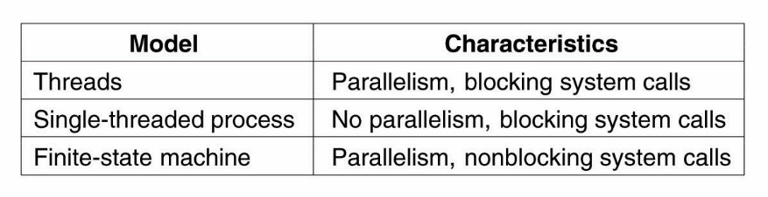
Multithreaded Servers continued….
Threads:-
Blocking system calls make programming easier & parallelism improves performance.
Single-threaded process:-
The single-threaded server retains the ease & simplicity of blocking system calls , gives up some amount of performance.
Finite-state machine :-
This, approach achieves high performance through parallelism but uses unblocking calls, thus is hard to program.
Figure : Three ways to construct a server.

Slide 13
Virtualization
Virtualization refers to the abstraction of computer resources.
Virtualization creates an external interface that hides an underlying implementation .
Two main categories:-
1) Platform virtualization:- refers to creating a virtual version of an entire computing platform. This can include the hardware, operating system, storage, and network resources, allowing multiple virtual environments to run on the same physical hardware. A common example is a hypervisor (like VMware, Hyper-V, or VirtualBox) that creates multiple virtual machines (VMs) on a single host, each capable of running different operating systems or applications.
2) Resource virtualization:- involves the simulation of combined, fragmented, or simplified resources.
Virtualization is a process of making a physical resource available as a virtual resources.
It allows to share single physical instance of a application or resource among multiple organization
Virtualization of specific system resources, such as storage volumes, name spaces, and network resources.

Slide 14
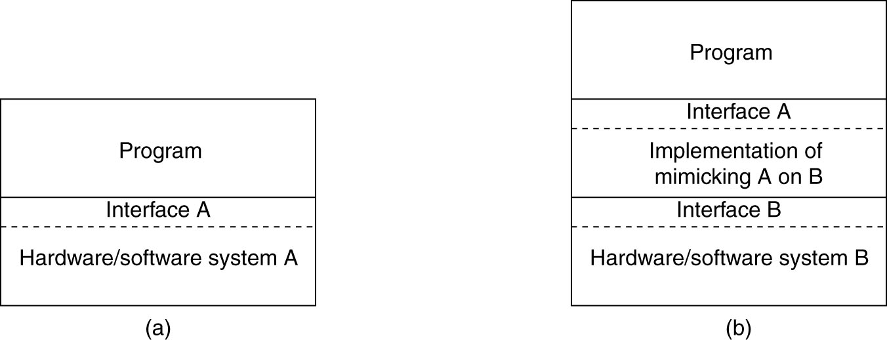
The Role of Virtualization in Distributed Systems
Figure : (a) General organization between a program, interface, and system.
(b) General organization of virtualizing system A on top of system B.

Slide 15
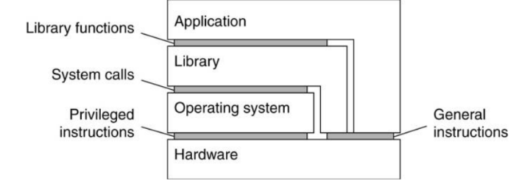
Architectures of Virtual Machines
Four distinct levels of interfaces:
An interface between the hardware and software consisting of machine instructions
that can be invoked by any program.
An interface between the hardware and software, consisting of machine instructions
that can be invoked only by privileged programs, such as an operating system.
An interface consisting of system calls as offered by an operating system.
An interface consisting of library calls
generally forming what is known as an application programming interface (API).
In many cases, the aforementioned system calls are hidden by an API.
Figure : Various interfaces offered by
computer systems

Slide 16
Virtualization can take place in two different ways:
1. Process virtual machine
Build a runtime system that provides an abstract instruction set that is to be used for executing applications.
Instructions can be interpreted (as is the case for the Java runtime environment), but could also be emulated as is done for running Windows applications on UNIX platforms.
2. Virtual machine monitor (VMM)
Implemented as a layer completely shielding the original hardware, but offering the complete instruction set of that same (or other hardware) as an interface.
This interface can be offered simultaneously to different programs.
Possible to have multiple, and different operating systems run independently and concurrently on the same platform.
Example: VMware and Xen.

Slide 17
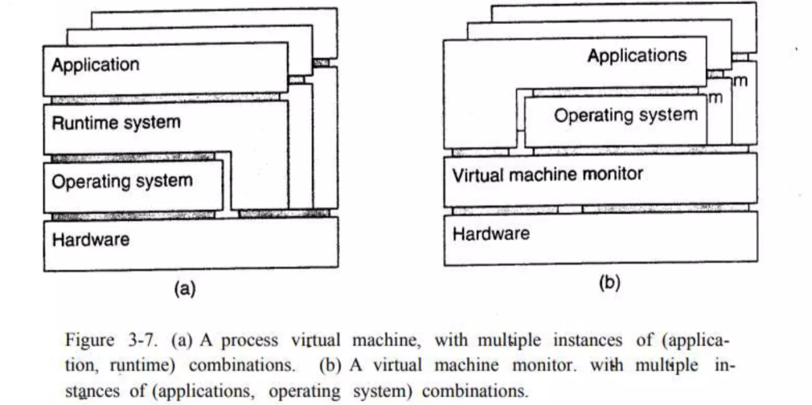

Slide 18
Software Agents
In distributed systems, a software agent is an autonomous software entity capable of performing specific tasks on behalf of users or other systems, often within a network of interconnected computers.
These agents can communicate, coordinate, and interact with other agents or system components to achieve complex objectives, sometimes with minimal human intervention.
One of best Feature of software agent is ability to act on its own---take intiative where appropriate. example:- “agent-based web crawler”.
Different s/w agents are below, these agents are independent to each other, based on resources & requriments.
i) Collaborative agent:- autonomy & cooperative
ii) Mobile agent:- ability to move b/w different m/c(portable).
iii) Interface agent:- assist end-user in the use of one or more applications.
iv) Information agent:- manage information from different sources.

Slide 19
Software agent continued…
Some important properties by which different types of agent can be distingshed. observe below,
Property | Common to all agents? | Description
Autonomous | YES | Can act on its own
Reactive | YES | Respond timely to change in its environment
Proactive | YES | Initiates action that affects its environment
Communicative | YES | Can exchange information with users & other agents
Continuous | NO | Has a relatively long life span
Mobile | NO | Can migrate from one site to other
Adaptive | NO | Capable of learning

Slide 20
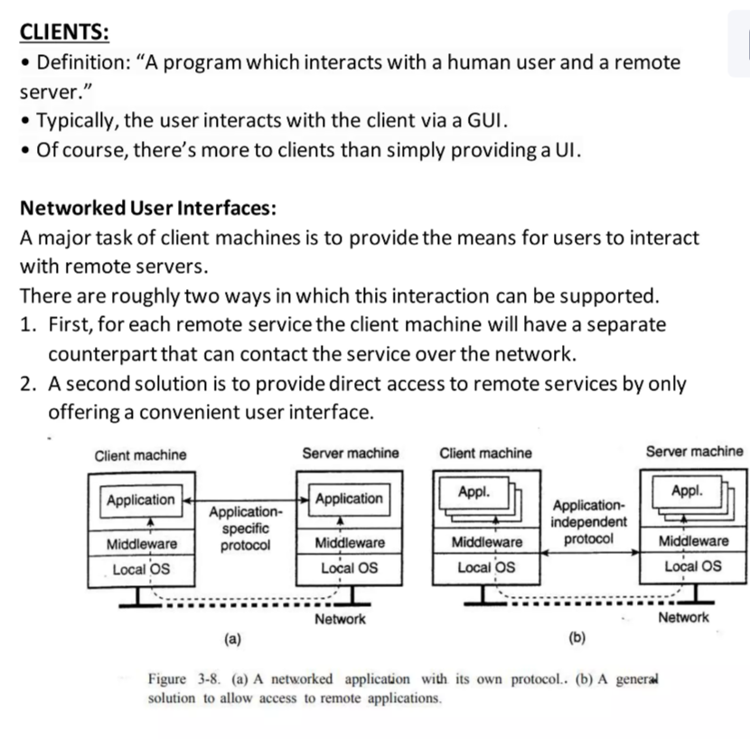

Slide 21
Example: The X Window System (X)
· Used to control bit-mapped terminals, which include a monitor, keyboard, and a pointing device such as a mouse.
· Viewed as that part of an operating system that controls the terminal.
· X kernel is heart of the system.
· Contains all the terminal-specific device drivers - highly hardware dependent.
· X kernel offers a low-level interface for controlling the screen and for capturing events from the keyboard and mouse.
· This interface is made available to applications as a library called Xlib.

Slide 22
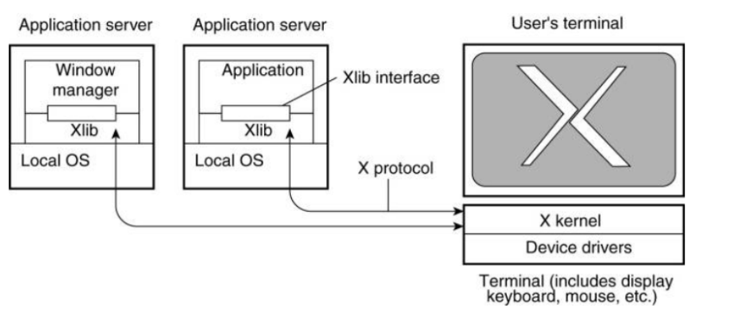
The basic organization of the X Window System.
X kernel and the X applications need not necessarily reside on the same machine.
X provides the X protocol, which is an application-level communication protocol by which an instance of Xlib can exchange data and events with the X kernel.

Slide 23
Client-Side Software for Distribution Transparency
Distribution transparency
· A client should not be aware that it is communicating with remote processes.
Access transparency
· Handled through the generation of a client stub from an interface definition of what the server has to offer.
· The stub provides the same interface as available at the server, but hides the possible differences in machine architectures, as well as the actual communication.
Location, Migration, and Relocation transparency
· A naming system is crucial
· Cooperation with client-side software is important
Example:
When a client is already bound to a server, the client can be directly informed when the server changes location.
The client's middleware can hide the server's current geographical location from the user, and also transparently rebind to the server if necessary.

Slide 24
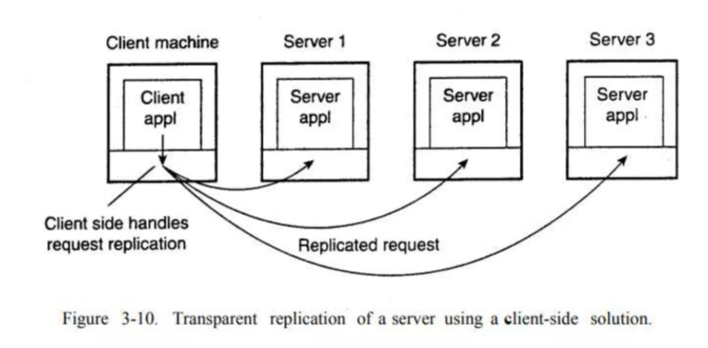
Contd..
Replication transparency
· Implemented as client-side solutions.
Example: a distributed system with replicated servers
Replication can be achieved by forwarding a request to each replica (figure).
Client-side software can transparently collect all responses and pass a single response to the client application.

Slide 25
Failure transparency
Masking communication failures with a server is typically done through client middleware.
Example: client middle-ware can be configured to repeatedly attempt to connect to a server
Client middleware can return data it had cached during a previous session, as is sometimes done by Web browsers that fail to connect to a server.
Concurrency transparency
Handled through special intermediate servers, notably transaction monitors, and requires less support from client software.
Persistence transparency
Completely handled at the server.

Slide 26
Servers
General Design Issues
A server is a process implementing a specific service on behalf of a collection of clients.
Each server is organized in the same way:
it waits for an incoming request from a client
ensures that the request is fulfilled
it waits for the next incoming request.
Several ways to organize servers:
Iterative server:
Iterative server handles request, then returns results to the client; any new client requests must wait for previous request to complete.
Concurrent server:
Server does not handle the request itself; a separate thread or sub-process handles the request and returns any results to the client; the server is then free to immediately service the next client (i.e., there’s no waiting, as service requests are processed in parallel).
Stateless server:
No information is maintained on the current “connections” to the server.
Eg: Web server.
Stateful: Information is maintained on the current “connections” to the server. Eg: File server

Slide 27
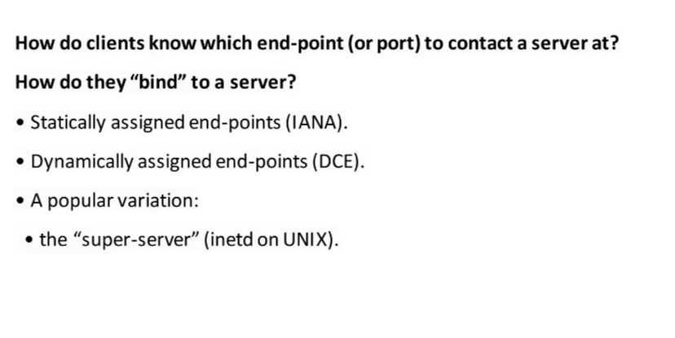
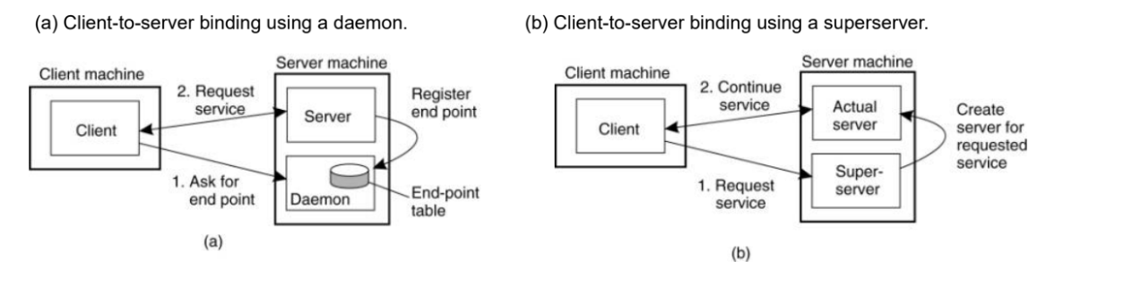

Slide 28
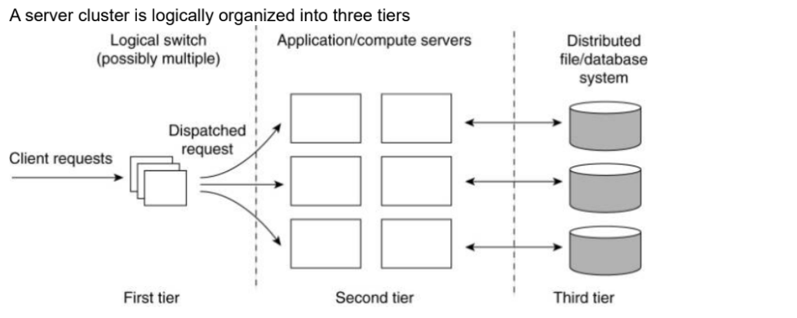
Server Clusters(1)
General Organization
A server cluster is a collection of machines connected through a network, where each machine runs one or more servers.

Slide 29
First tier - consists of a (logical) switch through which client requests are routed.
Switches vary:
o Transport-layer switches accept incoming TCP connection requests and pass requests on to one of servers in the cluster,
o A Web server that accepts incoming HTTP requests, but that partly passes requests to application servers for further processing only to later collect results and return an HTTP response.
Second tier: application processing.
Cluster computing servers run on high-performance hardware dedicated to delivering compute power.
Enterprise server clusters - applications may need to run on relatively low-end machines, as the required compute power is not the bottleneck, but access to storage is.
Third tier: data-processing servers - notably file and database servers.
o These servers may be running on specialized machines, configured for high-speed disk access and having large server-side data caches.

Slide 30
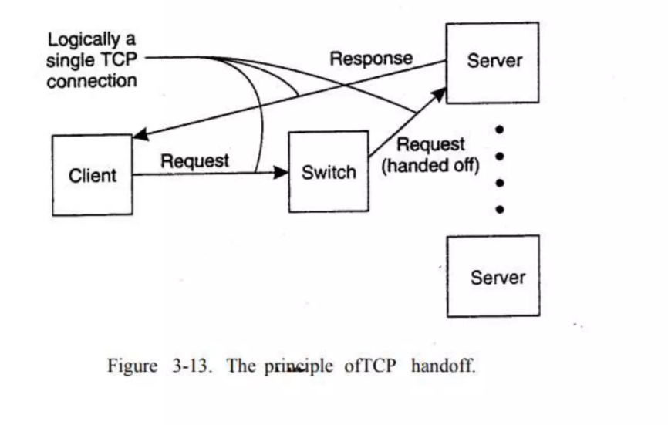
Server Clusters(2)
Standard way of accessing a server cluster - a TCP connection over which application-level requests are sent as part of a session. A session ends by tearing down the connection. In the case of transport-layer switches, the switch accepts incoming TCP connection requests, and hands off such connections to one of the servers.

Slide 31
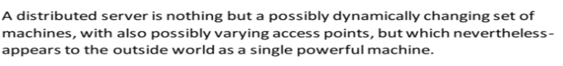
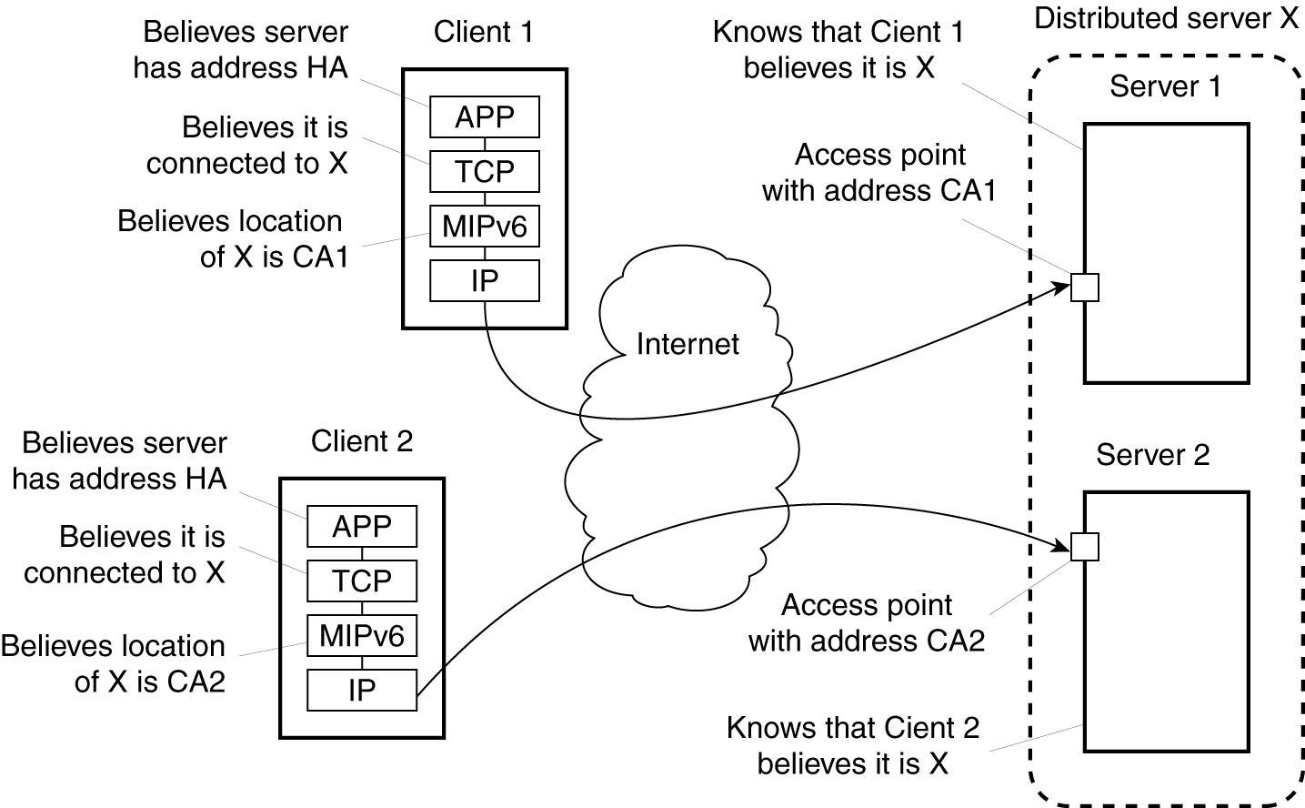
Distributed Servers
Figure : Route optimization in a distributed server.

Slide 32
Managing Server Clusters
A server cluster should appear to the outside world as a single computer.
Common Approaches
1. Extend the traditional managing functions of a single computer to that of a cluster (most common approach).
o an administrator can log into a node from a remote client and execute local managing commands to monitor, install, and
change components.
2. Provide an interface at an administration machine that allows collection of information from one or more servers, upgrade
components, add and remove nodes, etc.
o This type of managing server clusters is widely applied in practice (e.g. Cluster Systems Management from IBM)
3. Ad hoc.
o Managing thousands of servers, organized into many clusters but all operating collaboratively can not be done with centralized administration.
o Very large clusters need continuous repair management (including upgrades).
o If p is the probability that a server is currently faulty, and we assume that faults are independent, then for a cluster of N
servers to operate without a single server being faulty is (1-p)N. With p=0.001 and N=1000, there is only a 36 percent
chance that all the servers are correctly functioning.
o Rules of thumb that should be considered ,but there is no systematic approach to dealing with massive systems management.
o Cluster management is still in its infancy.

Slide 33
Example: PlanetLab
o PlanetLab is a collaborative distributed system in which different organizations each donate one or more computers, adding up to a total of hundreds of nodes.
o These computers form a 1-tier server cluster, where access, processing, and storage can all take place on each node individually.
o Management of PlanetLab is almost entirely distributed.
In PlanetLab:
· An organization donates one or more nodes, where each node is easiest thought of as just a single computer, although it could also be itself a cluster of machines.
· Each node is organized as shown in figure.
· There are two important components
1. The virtual machine monitor (VMM), which is an enhanced Linux operating system.
2. vservers.
o A (Linux) vserver is a separate environment in which a group of processes run.
§ Processes from different vservers are completely independent.
§ A vserver provides an environment consisting of its own collection of software packages, programs, and
networking facilities.
· The Linux VMM ensures that vservers are separated: processes in different vservers are executed concurrently and independently, each making use only of the software packages and programs available in their own environment.
· PlanetLab introduces the notion of a slice - a set of vservers, each vserver running on a different node.
o A slice is a virtual server cluster, implemented by means of a collection of virtual machines.

Slide 34
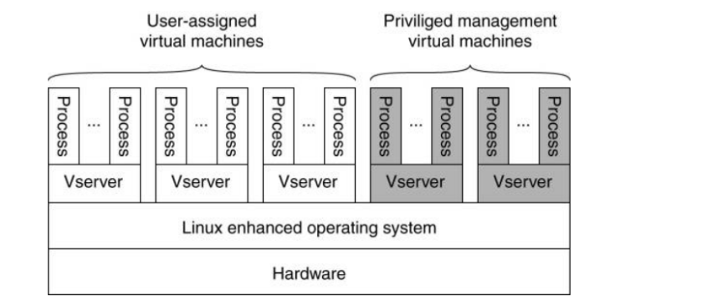
The basic organization of a PlanetLab node.

Slide 35
PlanetLab (1)
PlanetLab management issues:
Nodes belong to different organizations.
Each organization should be allowed to specify who is allowed to run applications on their nodes,
And restrict resource usage appropriately.
Monitoring tools available assume a very specific combination of hardware and software.
All tailored to be used within a single organization.
Programs from different slices but running on the same node should not interfere with each other.

Slide 36
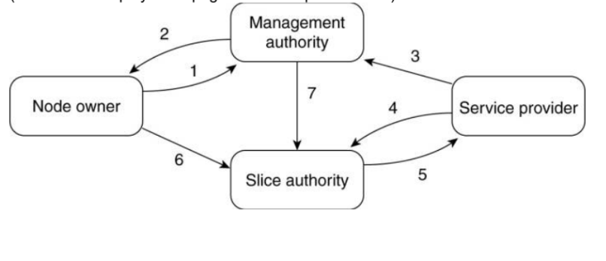
Relationships between PlanetLab entities:
1. A node owner puts its node under the regime of a management authority, possibly restricting usage where appropriate.
2. A management authority provides the necessary software to add a node to PlanetLab.
3. A service provider registers itself with a management authority, trusting it to provide well-behaving nodes.
4. A service provider contacts a slice authority to create a slice on a collection of nodes.
5. The slice authority needs to authenticate the service provider.
6. A node owner provides a slice creation service for a slice authority to create slices. It essentially delegates resource management
to the slice authority.
7. A management authority delegates the creation of slices to a slice authority.
The management relationships between various PlanetLab entities.

Slide 37
Code migration
It refers to the process of moving code or an entire application from one environment, platform, or framework to another.
Reasons for code migration:
1.Better performance
Improve computing performance by moving process from heavily loaded machine to lightly loaded machine.
2.Flexibility
Improve communication time by shipping code to systems where large data sets reside.

Slide 38
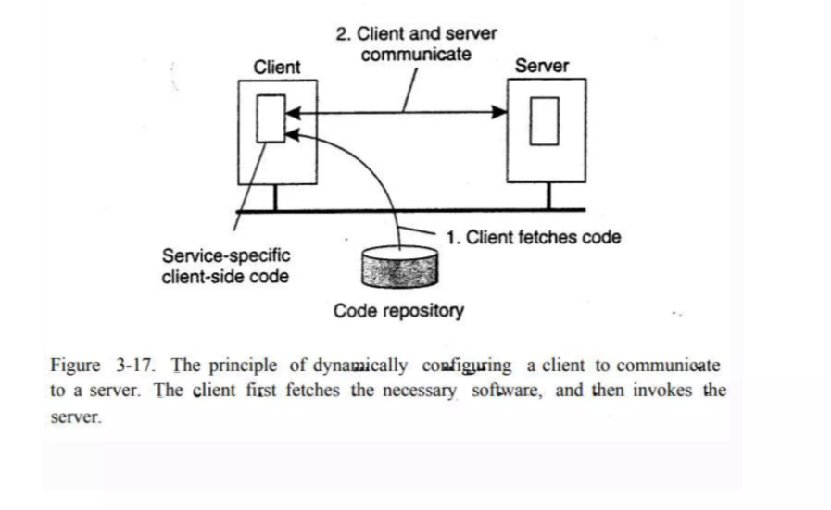
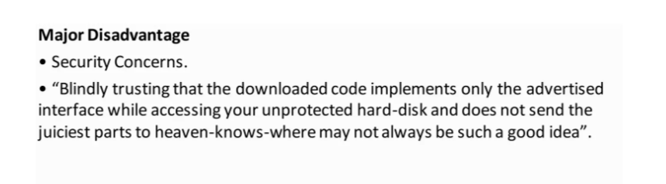

Slide 39
Models for Code Migration
A process consists of 3 segments:
Code segment is a part that contains set of instructions that make up the program that is being executed.
Resource segment conatins references to the external resources such as files ,printers,devices and so on.
Execution segment is used to store the current execution state of process.
Types:
Weak migration/mobility: only code segment migrated.
Strong migration/mobility: code and execution can both be transferred.
Migration can be further divided into sender-initiated and receiver-initiated.
Sender-initiated migration : It is initiated at the machine where code currently resides or is being executed.
Uploading code to the server.
Receiver-initiated migration : The initiative for code migration is done at target machine.
Downloading code server by a client.

Slide 40
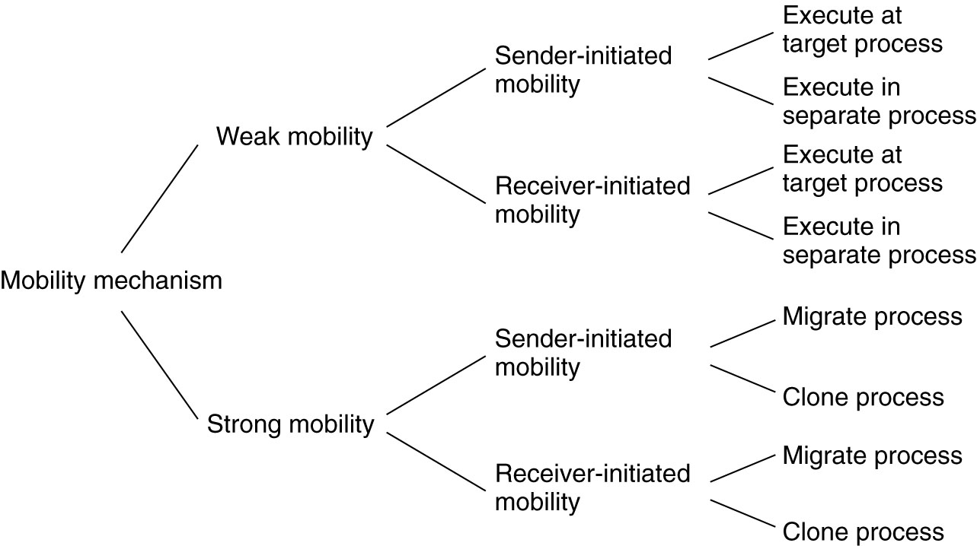
Figure : Alternatives for code migration.

Slide 41
Migration in Heterogeneous Systems
Three ways to handle migration (which can be combined)
Pushing memory pages to the new machine and resending the ones that are later modified during the migration process.
Stopping the current virtual machine; migrate memory, and start the new virtual machine.
Letting the new virtual machine pull in new pages as needed, that is, let processes start on the new virtual machine immediately and copy memory pages on demand.

